Slide 1

Online book Review System

Slide 2
Done BY
ID | Name | Batch | Group
2563488 | Arpit Singh | 230 Java SL VA | 8
2563117 | Devisetty Reddy Navya | 230 Java SL VA | 8
2563121 | Jayadhivyamani J | 230 Java SL VA | 8
2563766 | Niharika Das | 230 Java SL VA | 8
2563694 | Pooja Singh | 230 Java SL VA | 8
2563405 | Pullimaddi Venkata Revanth | 230 Java SL VA | 8
2563679 | Ankita Mishra | 230 Java SL VA | 8

Slide 3
Project Objective
The Book Review System is a web application project.
This project implements a web-based online book review system.
This system provides passionate book readers to express their feelings in order to encourage new readers to read books.

Slide 4
Background of the project
“ENZ Book Club” is an online book review blog where users can register and share their reviews on a list of books.
Users can like, comment and share the books which are good reads.
As a result, the team decided to hire a Full Stack developer who could develop a book review blog with a rich and user-friendly interface.
As a Full Stack Java developer we were asked to develop the web application.
The management team has provided us with the requirements and their business model so we can arrange different components of the application.

Slide 5





Technologies used

Slide 6
Angular:
Angular is a platform and framework for building single-page client applications using HTML and TypeScript.
Angular is written in TypeScript.
Spring Boot:
Spring Boat is an open-source Tools. Spring Boot is a project that is built on the top of the Spring Framework.
It provides an easier and faster way to set up, configure, and run both simple and web-based applications.
Post man:
The Postman testing tool is a complete API development platform with various built-in tools that support every stage of the API lifecycle.
Postman is an API client that makes it easy for developers to create, share, test and document APIs.

Slide 7
HTML & CSS:
HTML (the Hypertext Markup Language) and CSS (Cascading Style Sheets) are two of the core technologies for building Web pages.HTML provides the structure of the page, CSS the (visual and aural) layout, for a variety of devices.
Along with graphics and scripting, HTML and CSS are the basis of building Web pages and Web Applications.
HTML is the language for describing the structure of Web pages and CSS is the language for describing the presentation of Web pages, including colors, layout, and fonts.
MYSQL:
MySQL is an open source relational database management system.(RDBMS) developed by Oracle that is based on structured query language (SQL).
As with other relational databases, MySQL stores data in tables made up of rows and columns.
Users can define, manipulate, control, and query data using Structured Query Language, more commonly known as SQL.

Slide 8
The system comprises of 2 major modules with their sub-modules as follows:
MODULES
1. Admin :
Admin Login
Add & Remove Book
Editing Book Details
View Rating Lists

Slide 9
E-R Diagram For Admin
name
password
View Book list
View Rating List
login
Admin dashboard
logout
Id
Bookname
name
Review
Rating
View review list
Book list
Add new book
Edit
Delete
Id
Name
Author
Price
Category
View Book List
Add New Book

Slide 10
2. User :
Login & Register
Update Profile
Searching & Filtering the Books
Adding Reviews

Slide 11
E-R Diagram For User
Login
Register
User
id
Name password
Email
Phone
Address
Register
Logout
Id
Book name
Username
Rating
Review
Review, Rating
Review
Rating
Name
password
User Dashboard
login

Slide 12
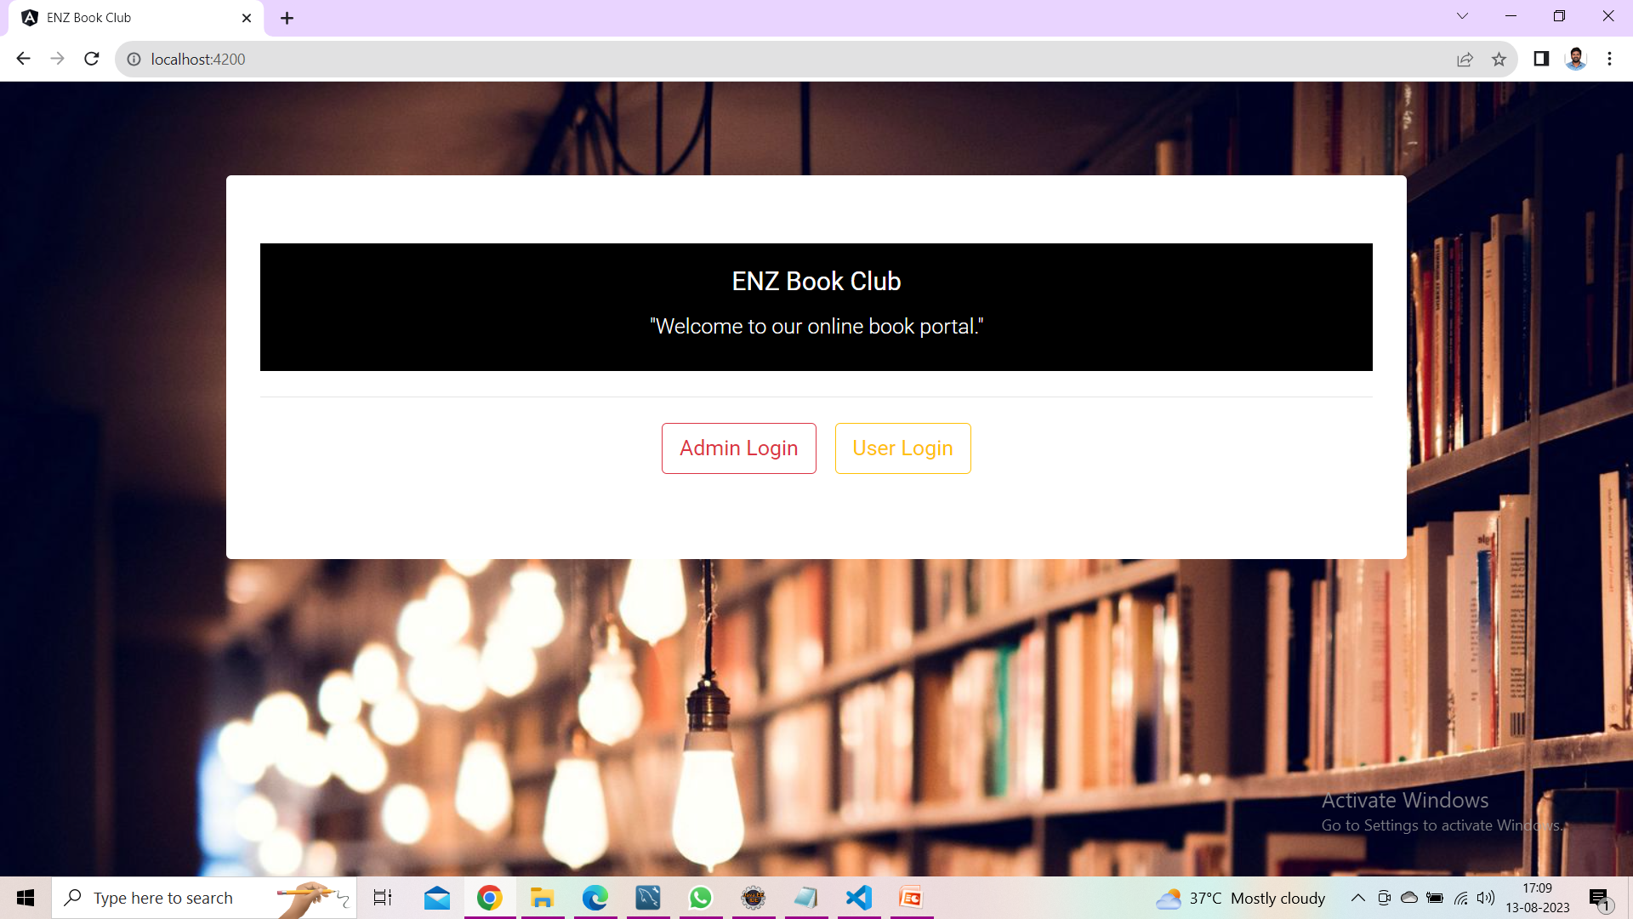
Homepage

Slide 13
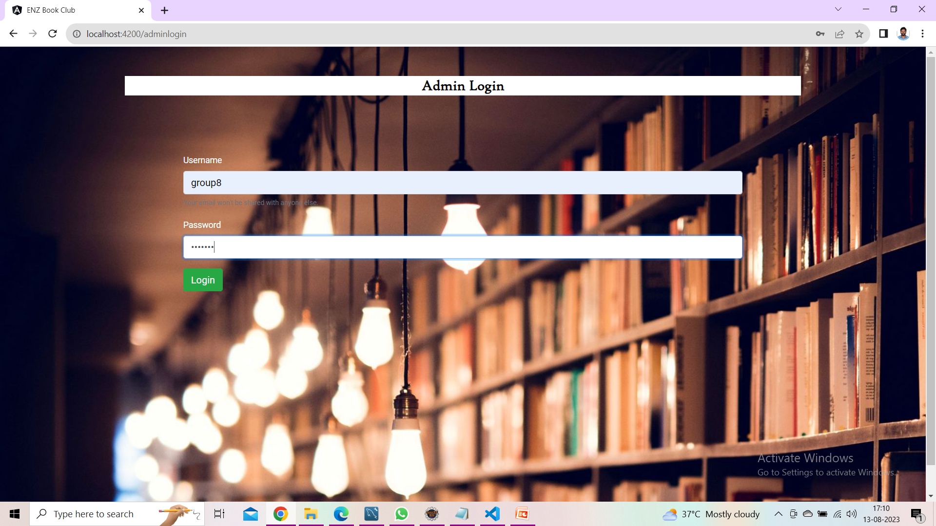
Admin Login

Slide 14
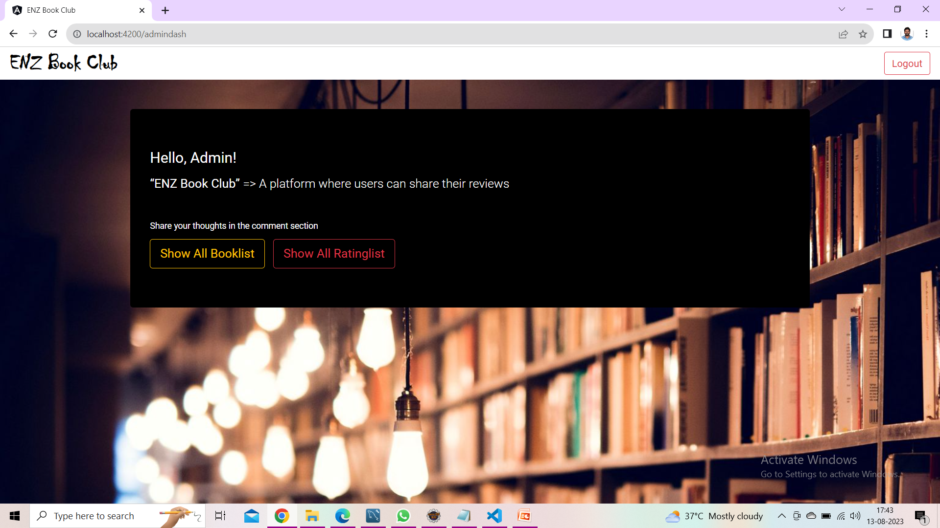
Admin Dashboard

Slide 15
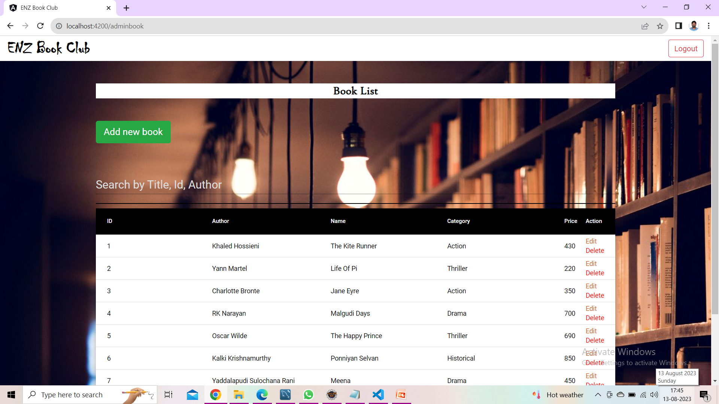
Admin BookList

Slide 16
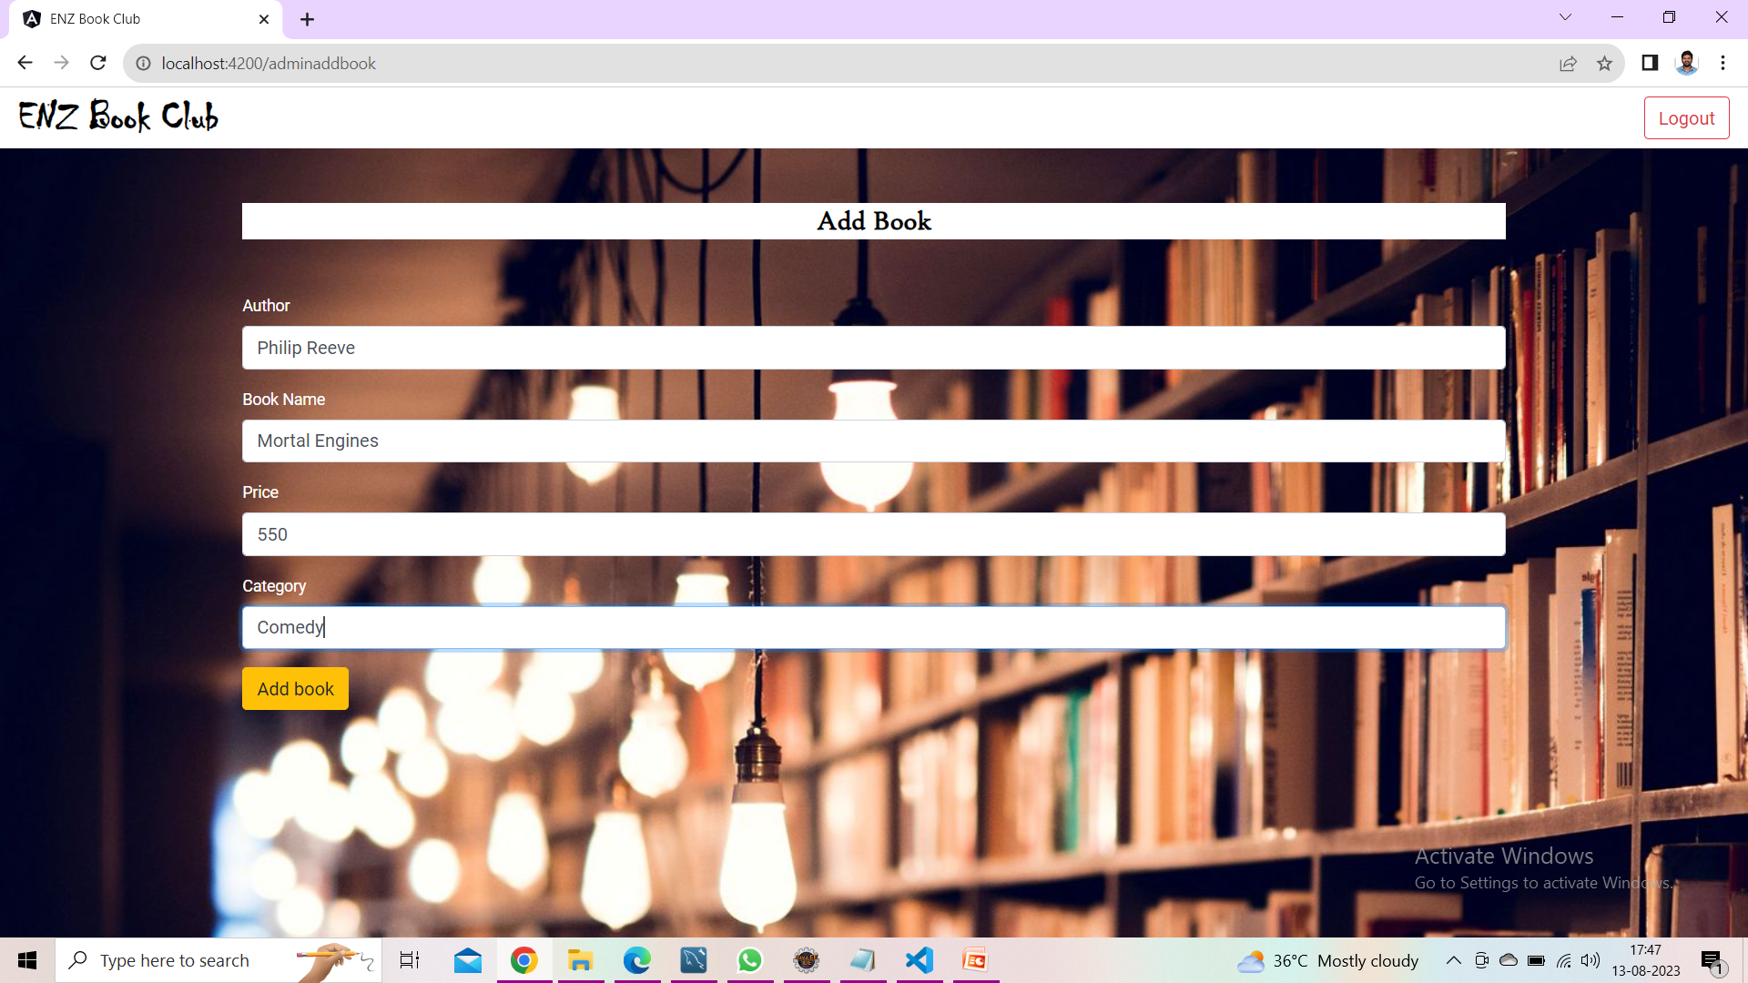
Add Book

Slide 17
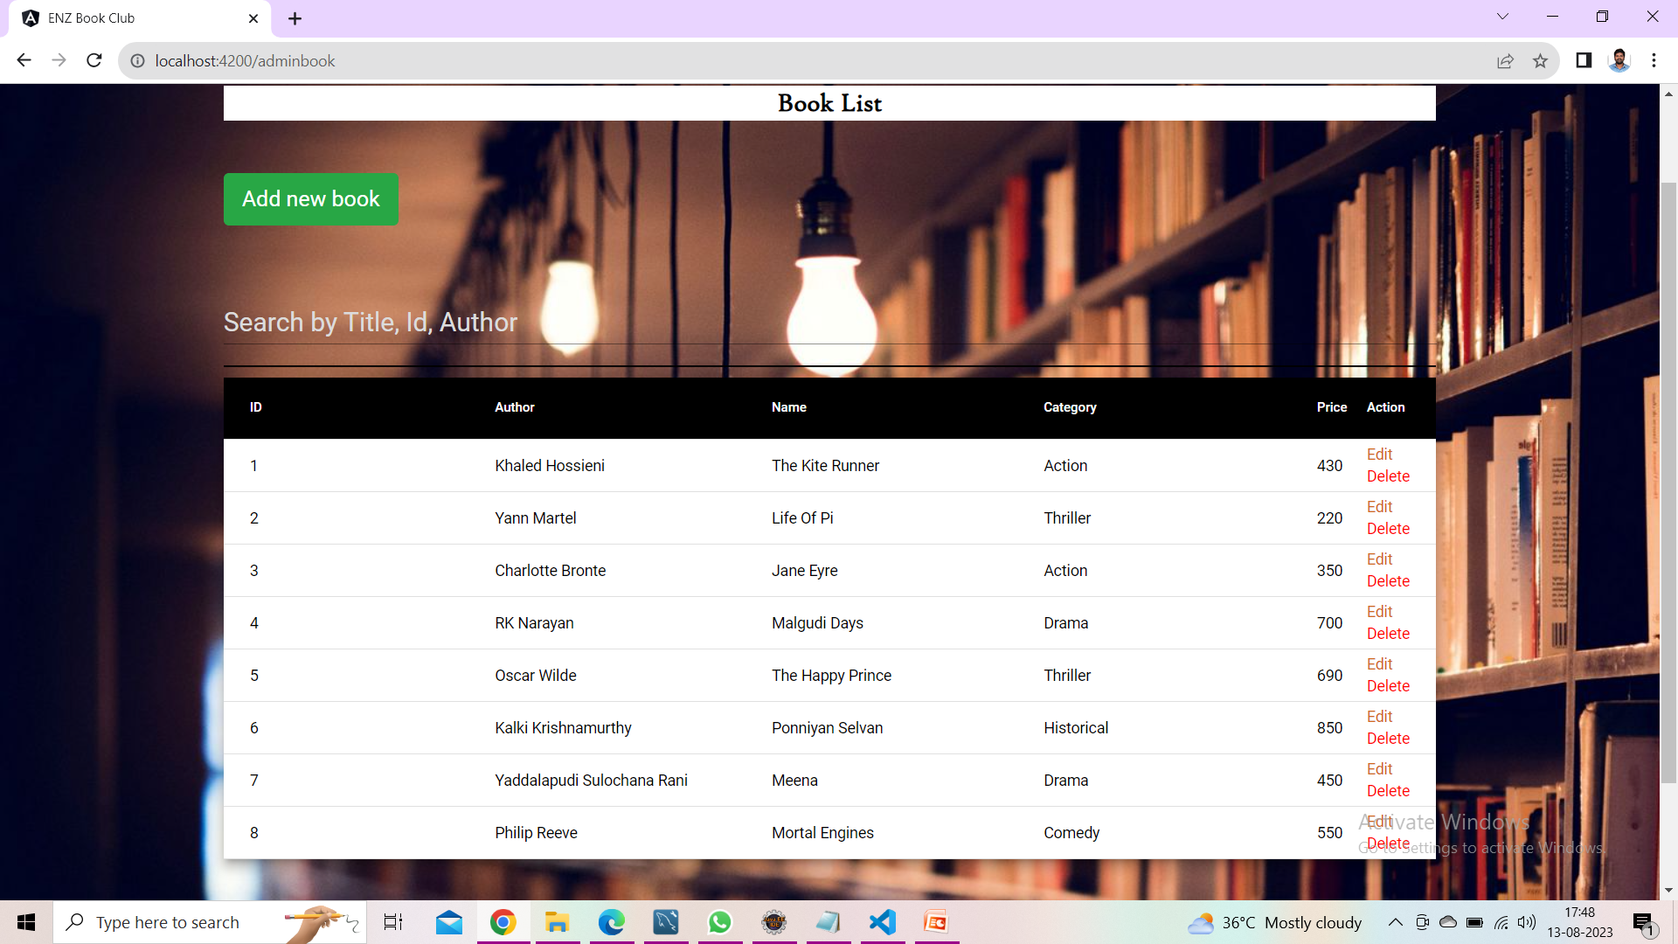
Admin BookList with added book

Slide 18
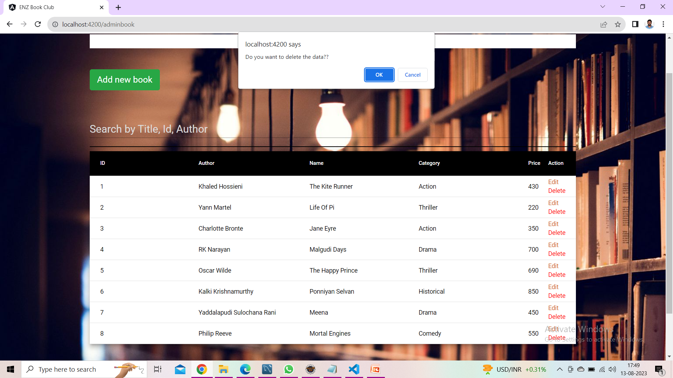
Delete Book

Slide 19
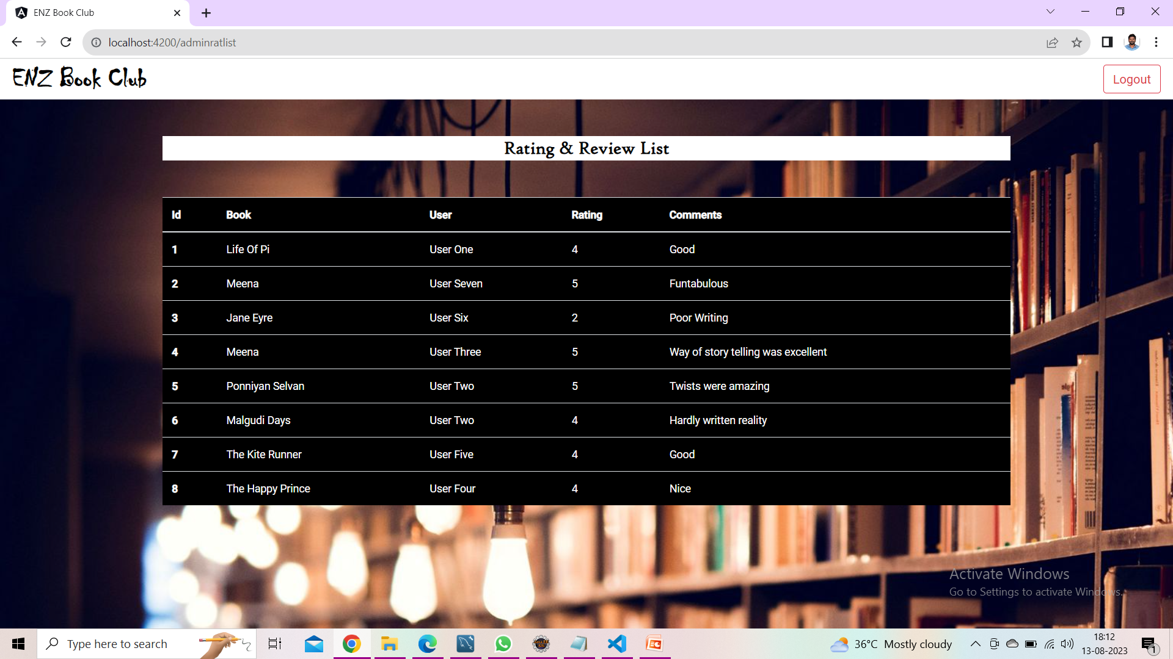
Rating and Review List

Slide 20
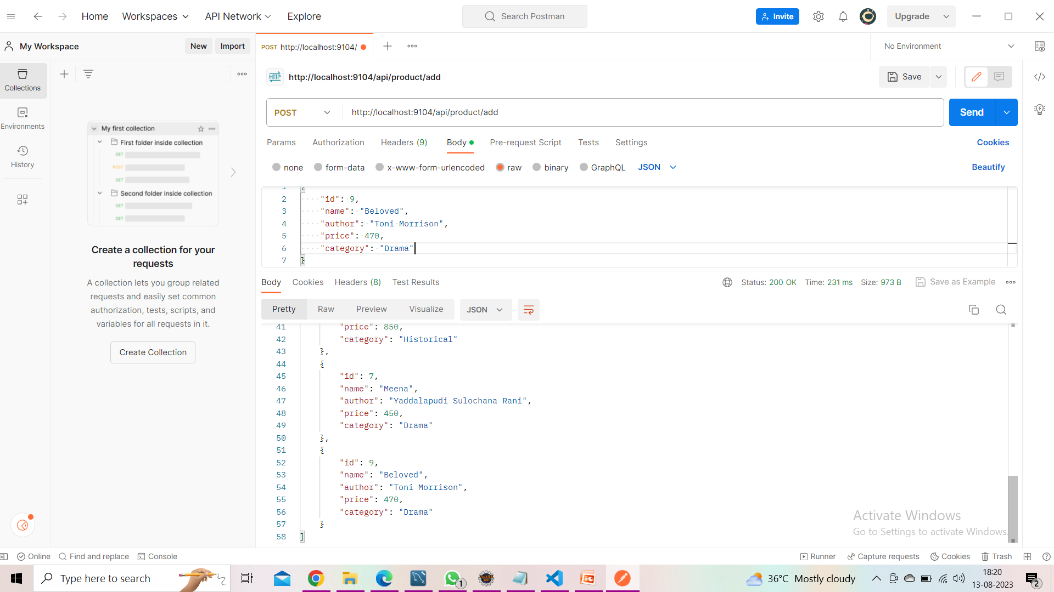
Adding Book in Postman

Slide 21
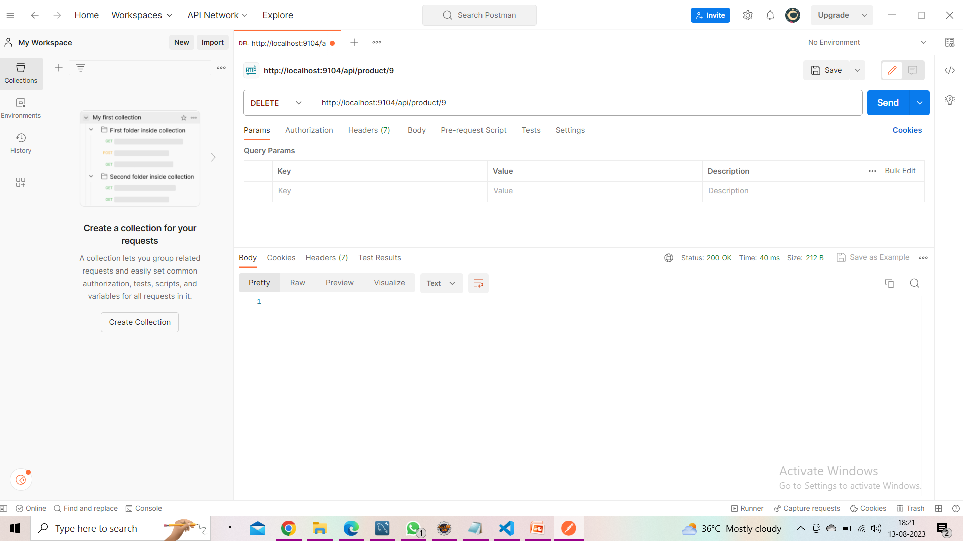
Deleting Book in Postman

Slide 22
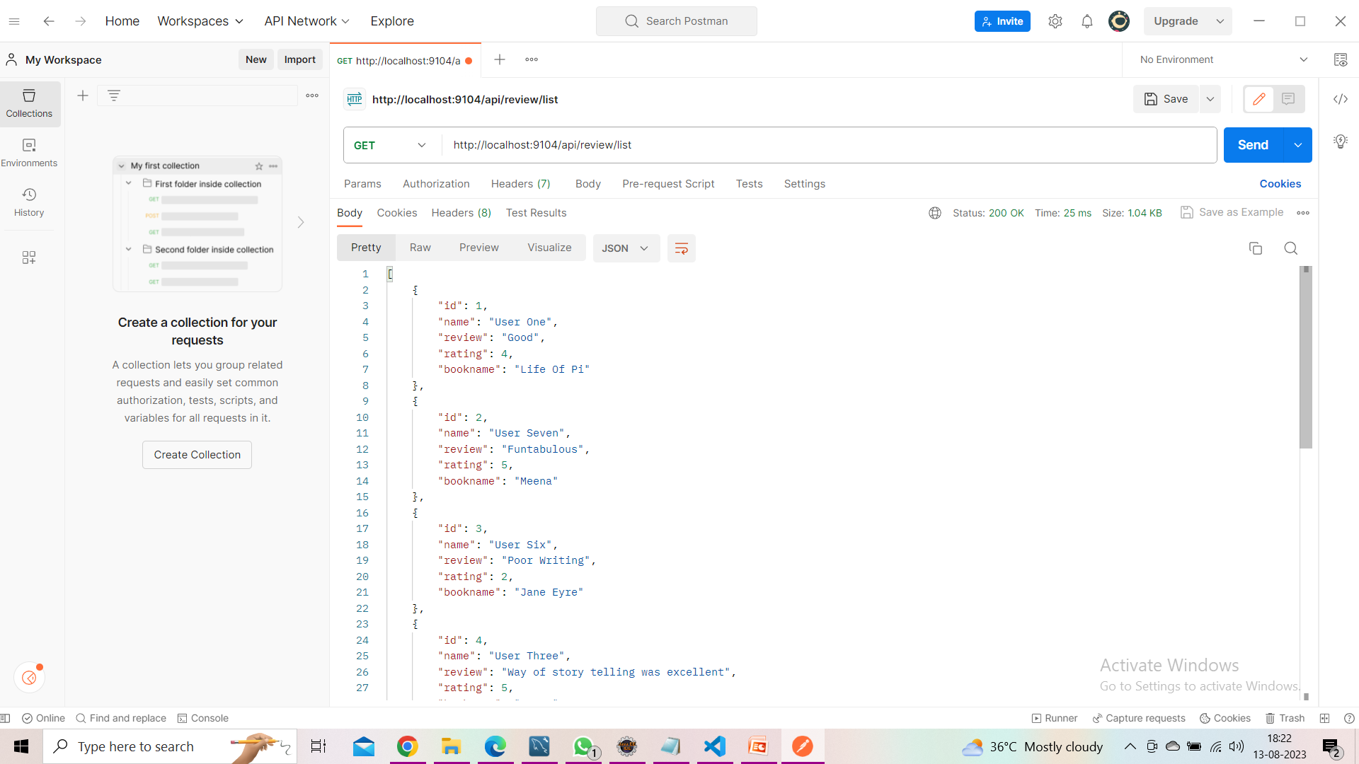
Rating and Review List in Postman

Slide 23
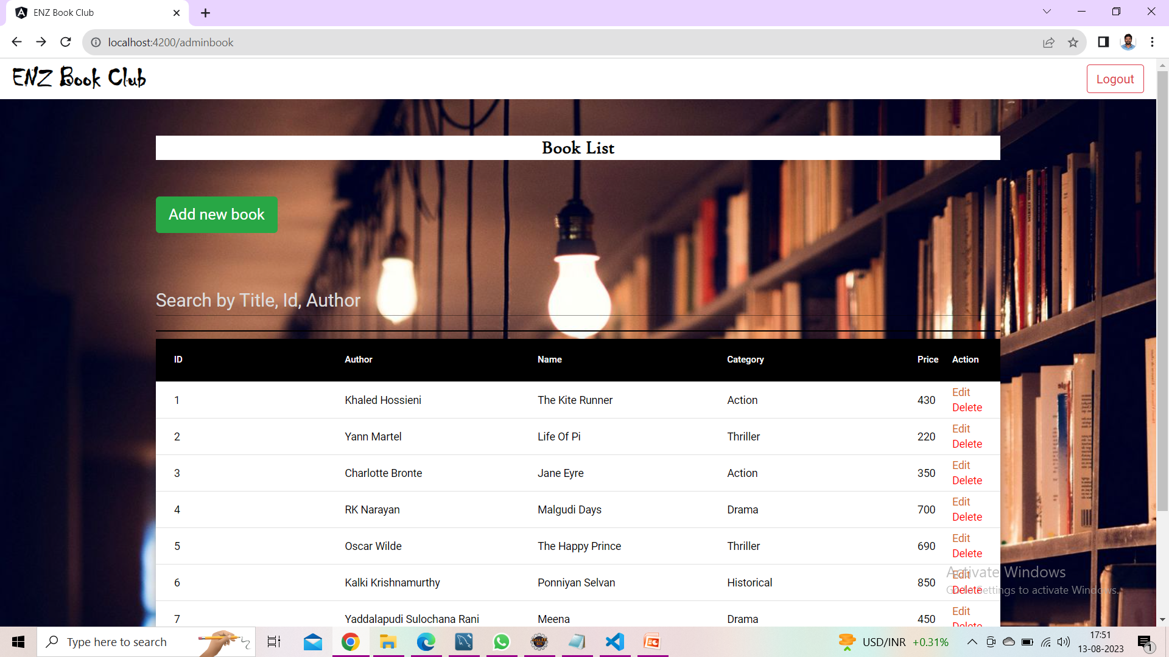
Admin Booklist before editing the price of the book id:1

Slide 24
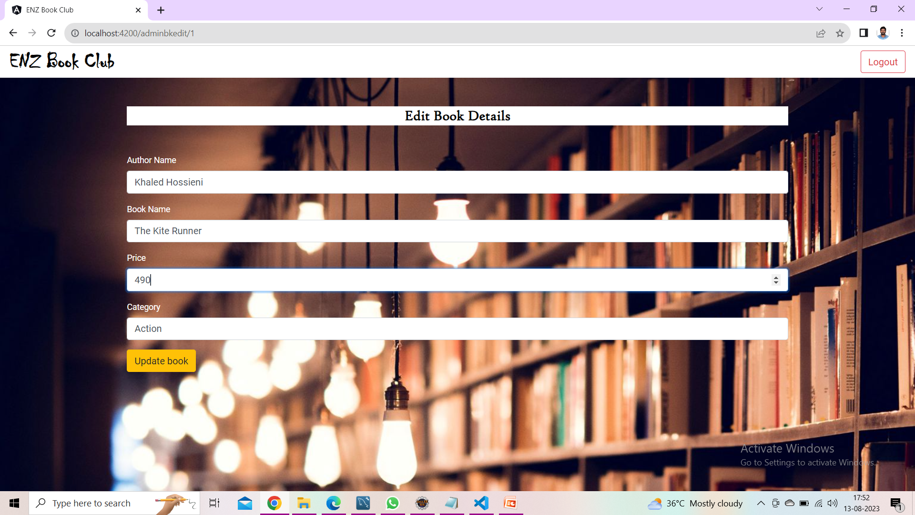
Edit Book Details

Slide 25
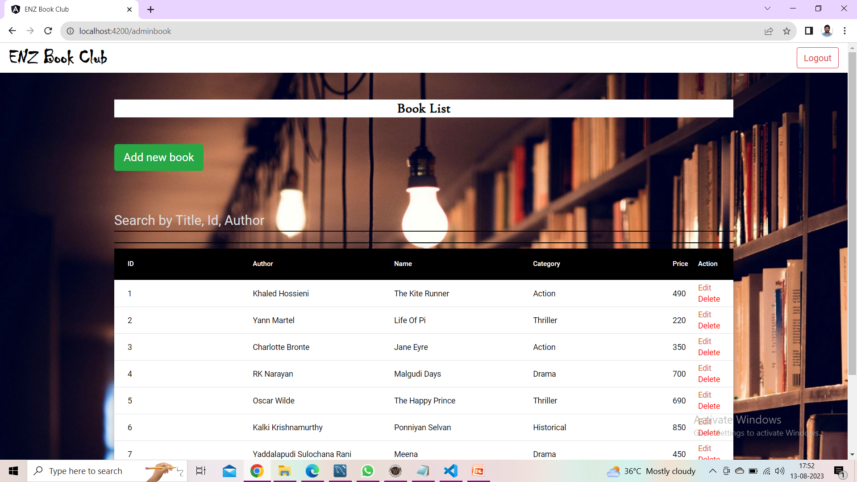
Admin Booklist after editing the price of the book id:1

Slide 26
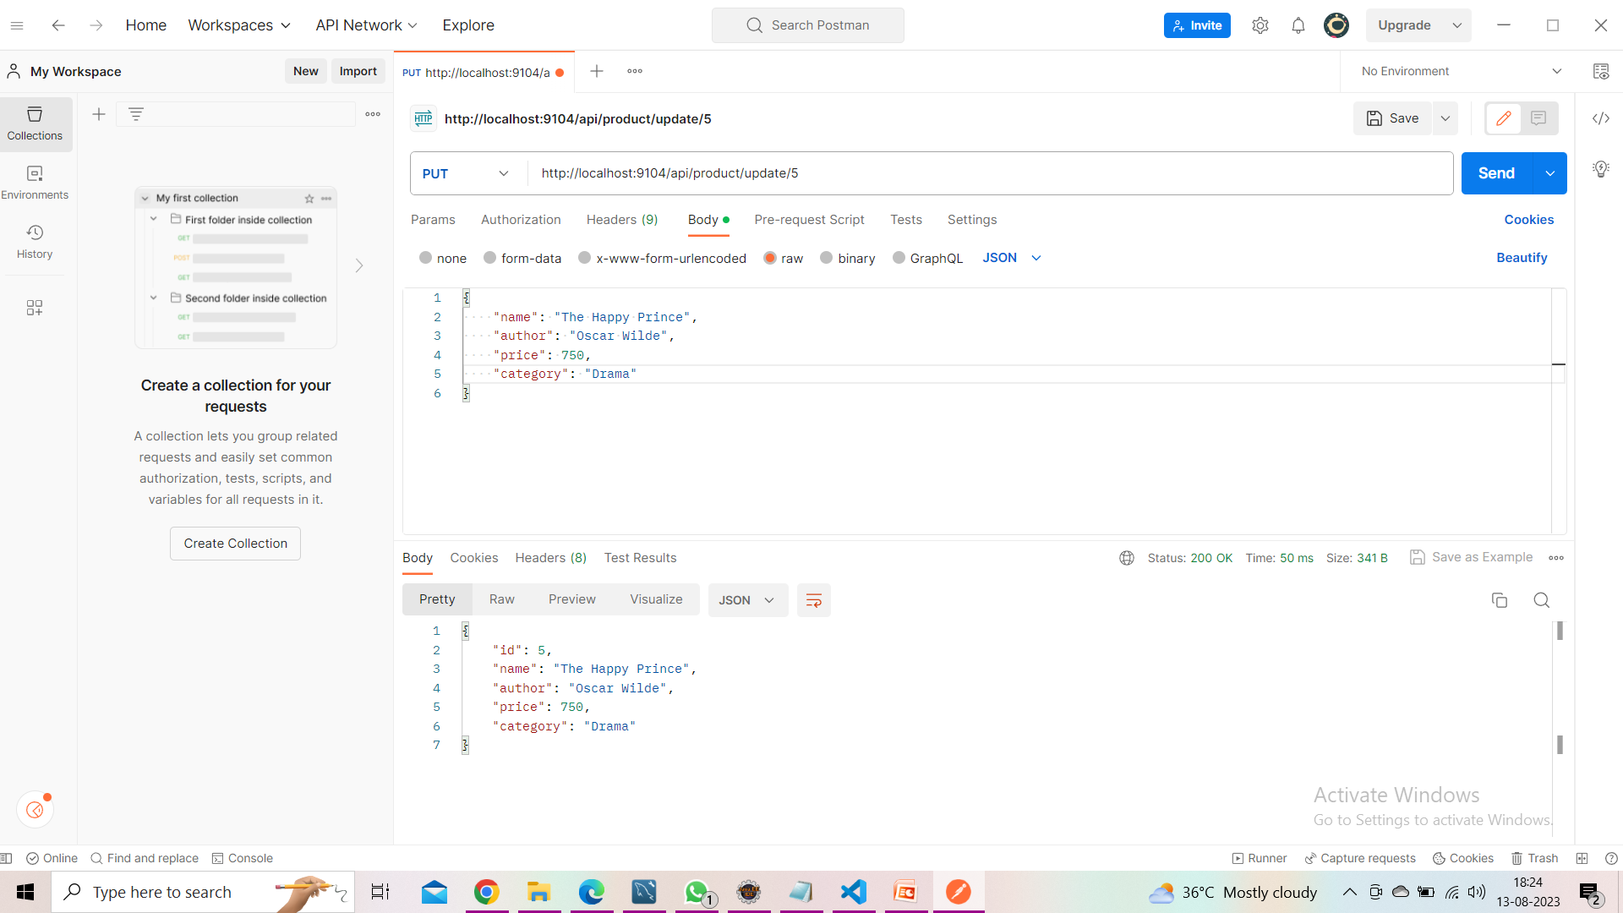
Editing the book id:5 in Postman

Slide 27
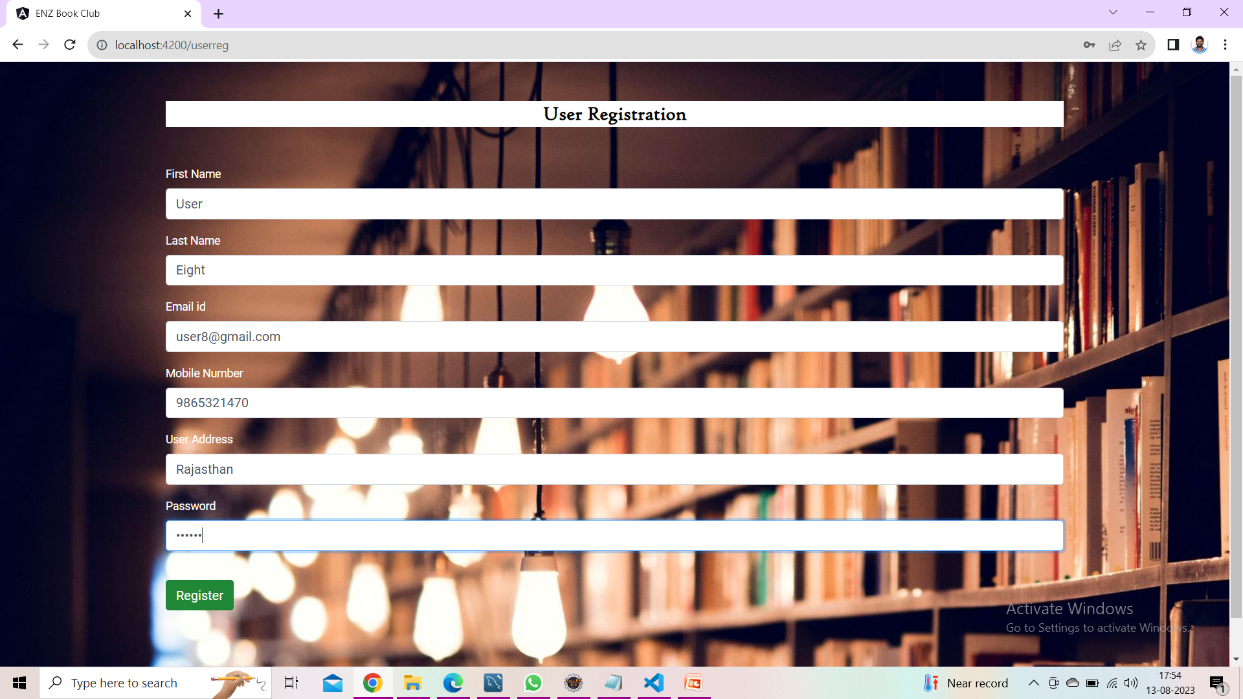
User Registration

Slide 28
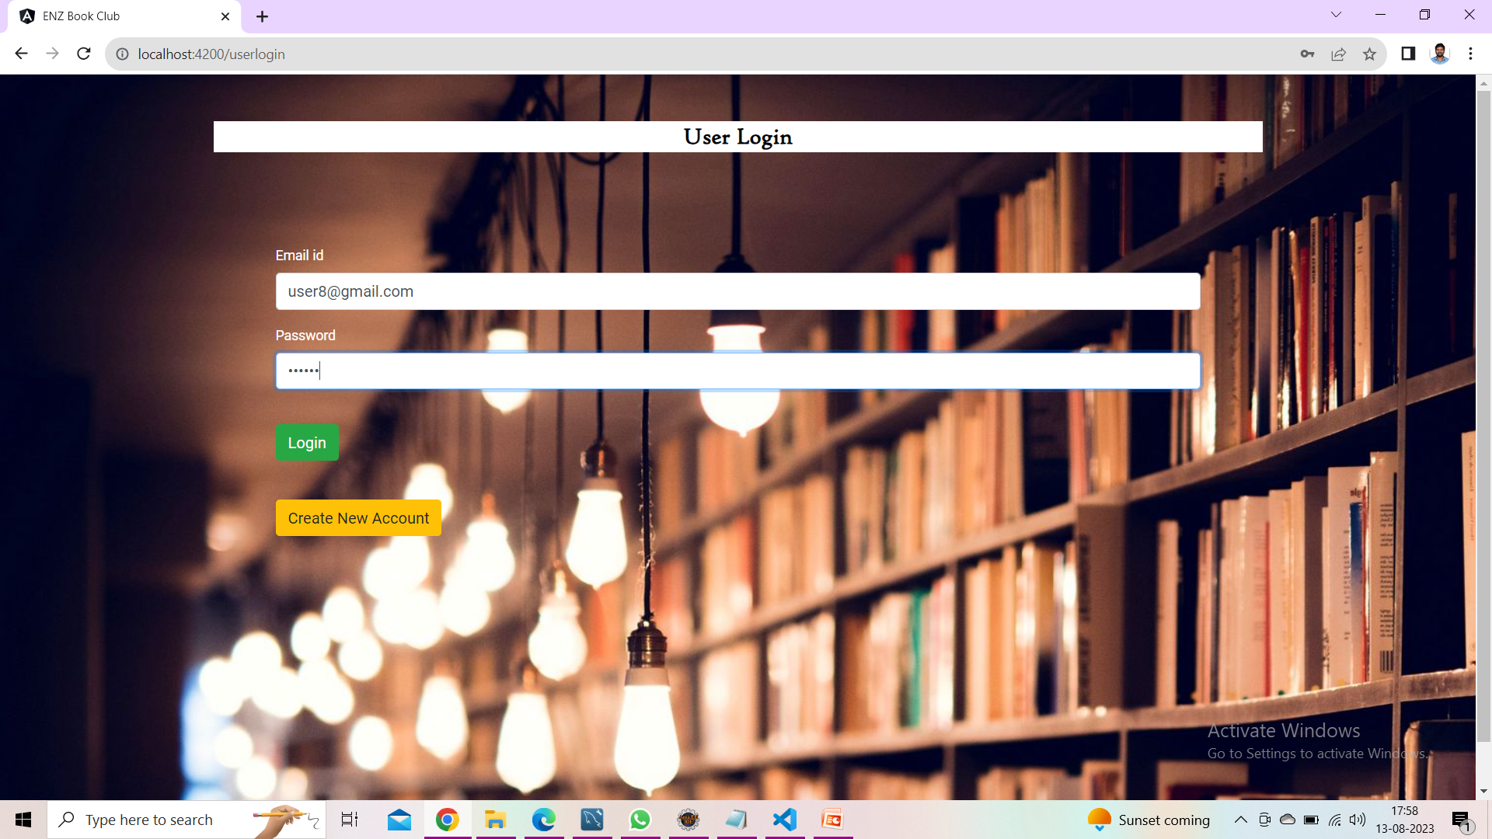
User Login

Slide 29
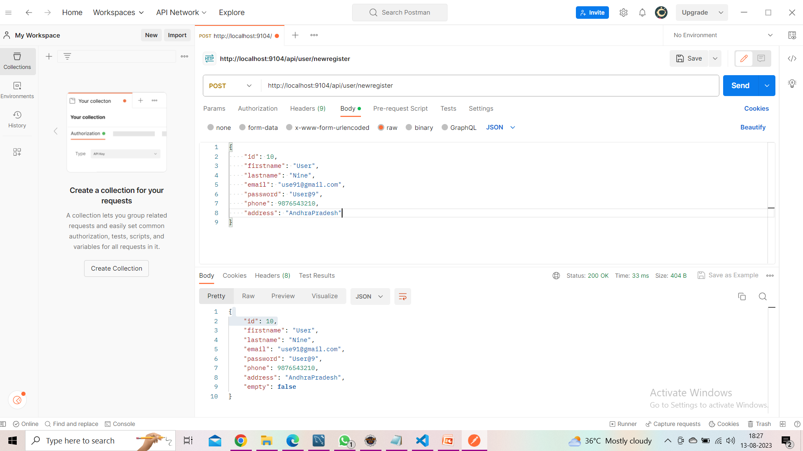
User Registration in Postman

Slide 30
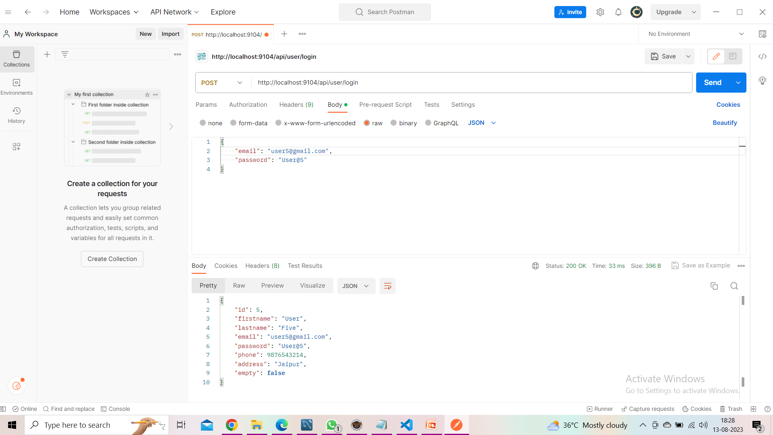
User Login in Postman

Slide 31
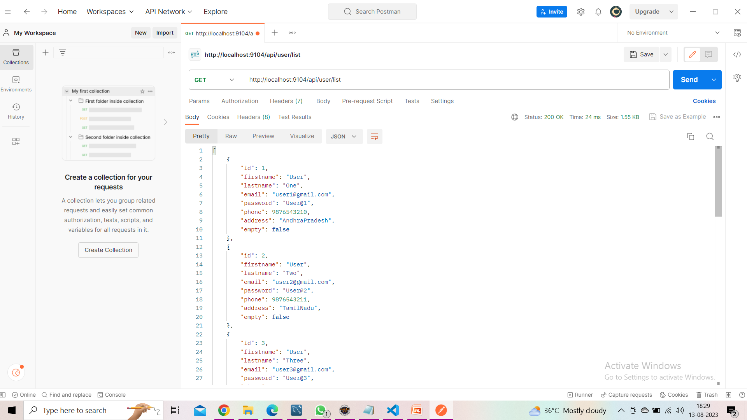
Users List in Postman

Slide 32
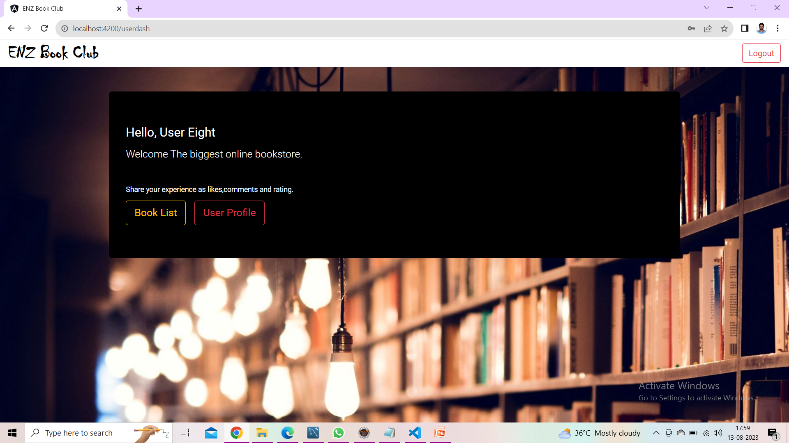
User Dashboard

Slide 33
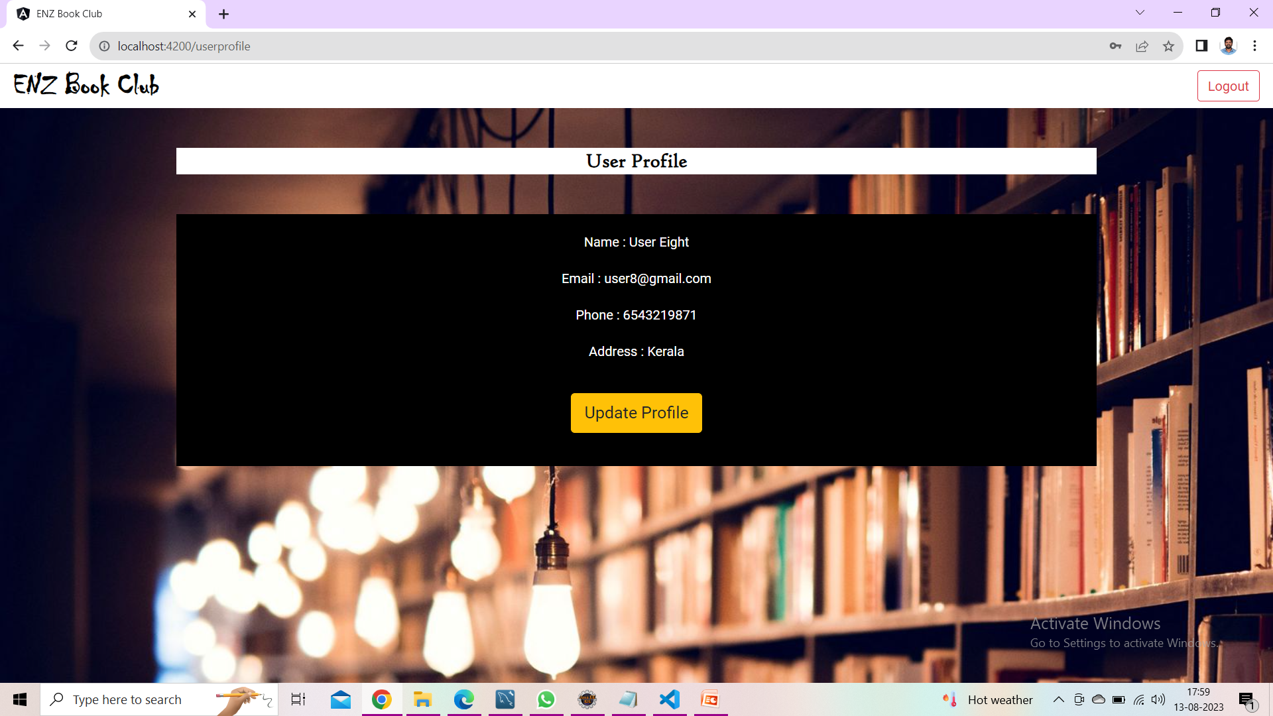
User Profile

Slide 34
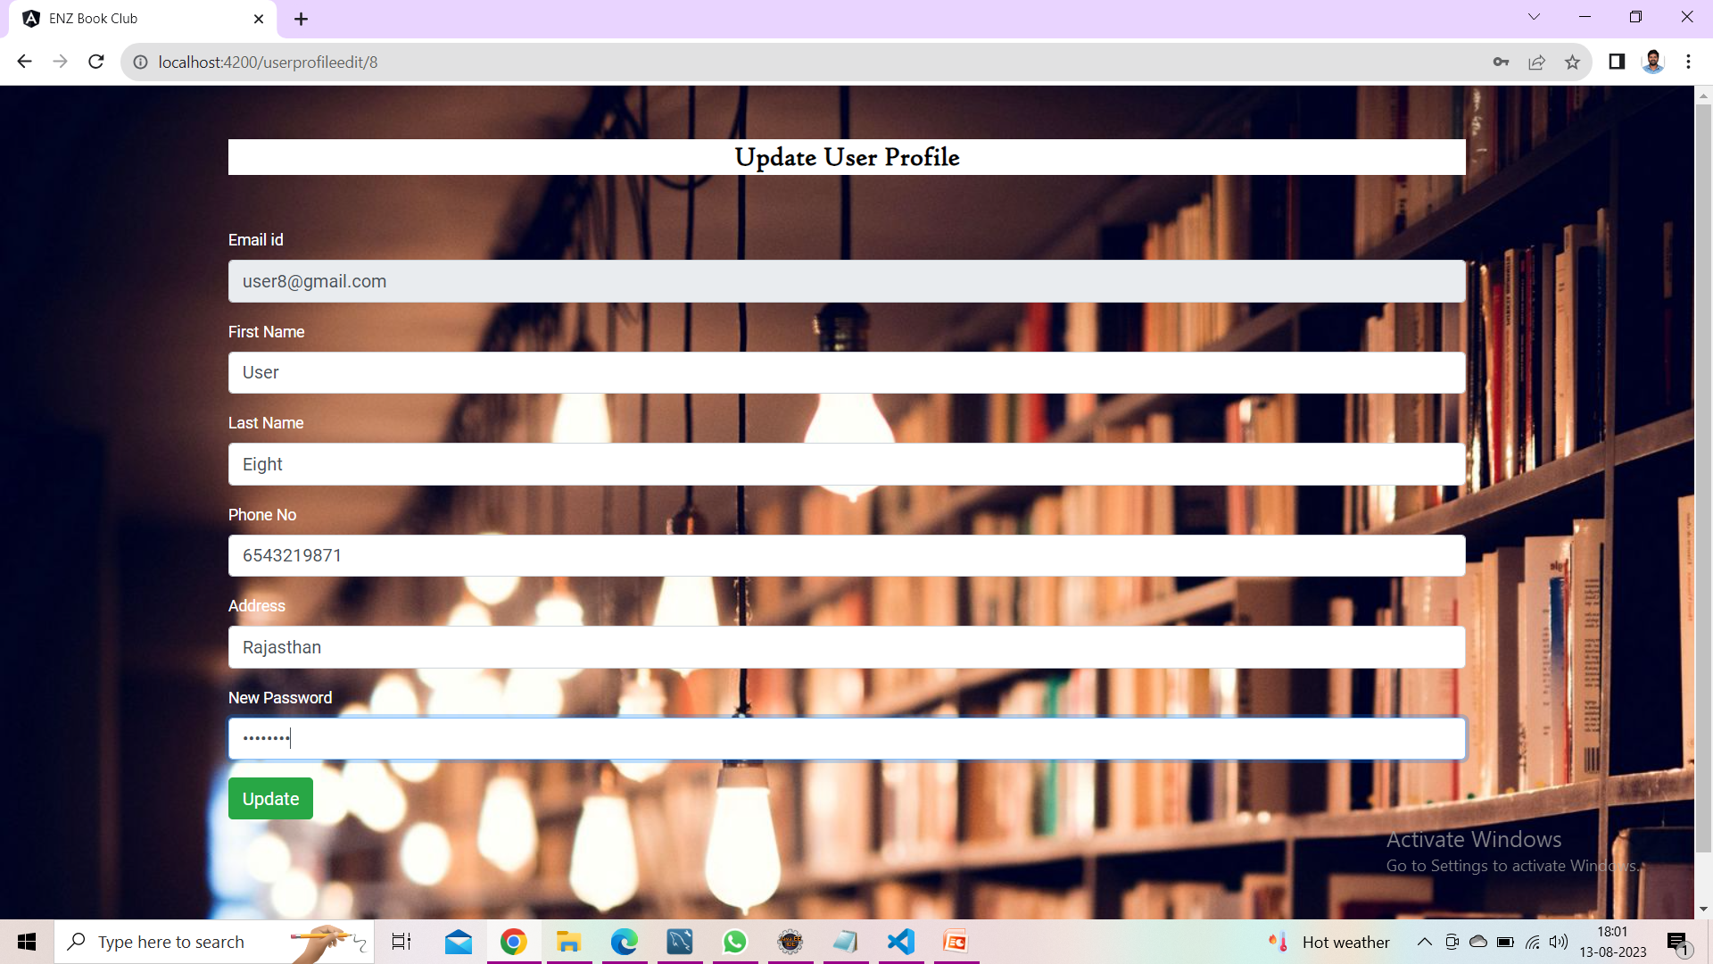
Update User Profile

Slide 35

User Profile after Updating

Slide 36
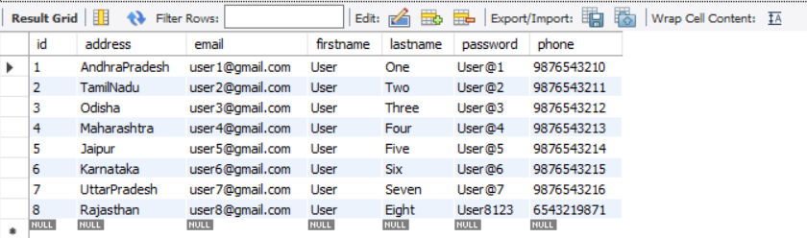
Password has been changed for user eight

Slide 37
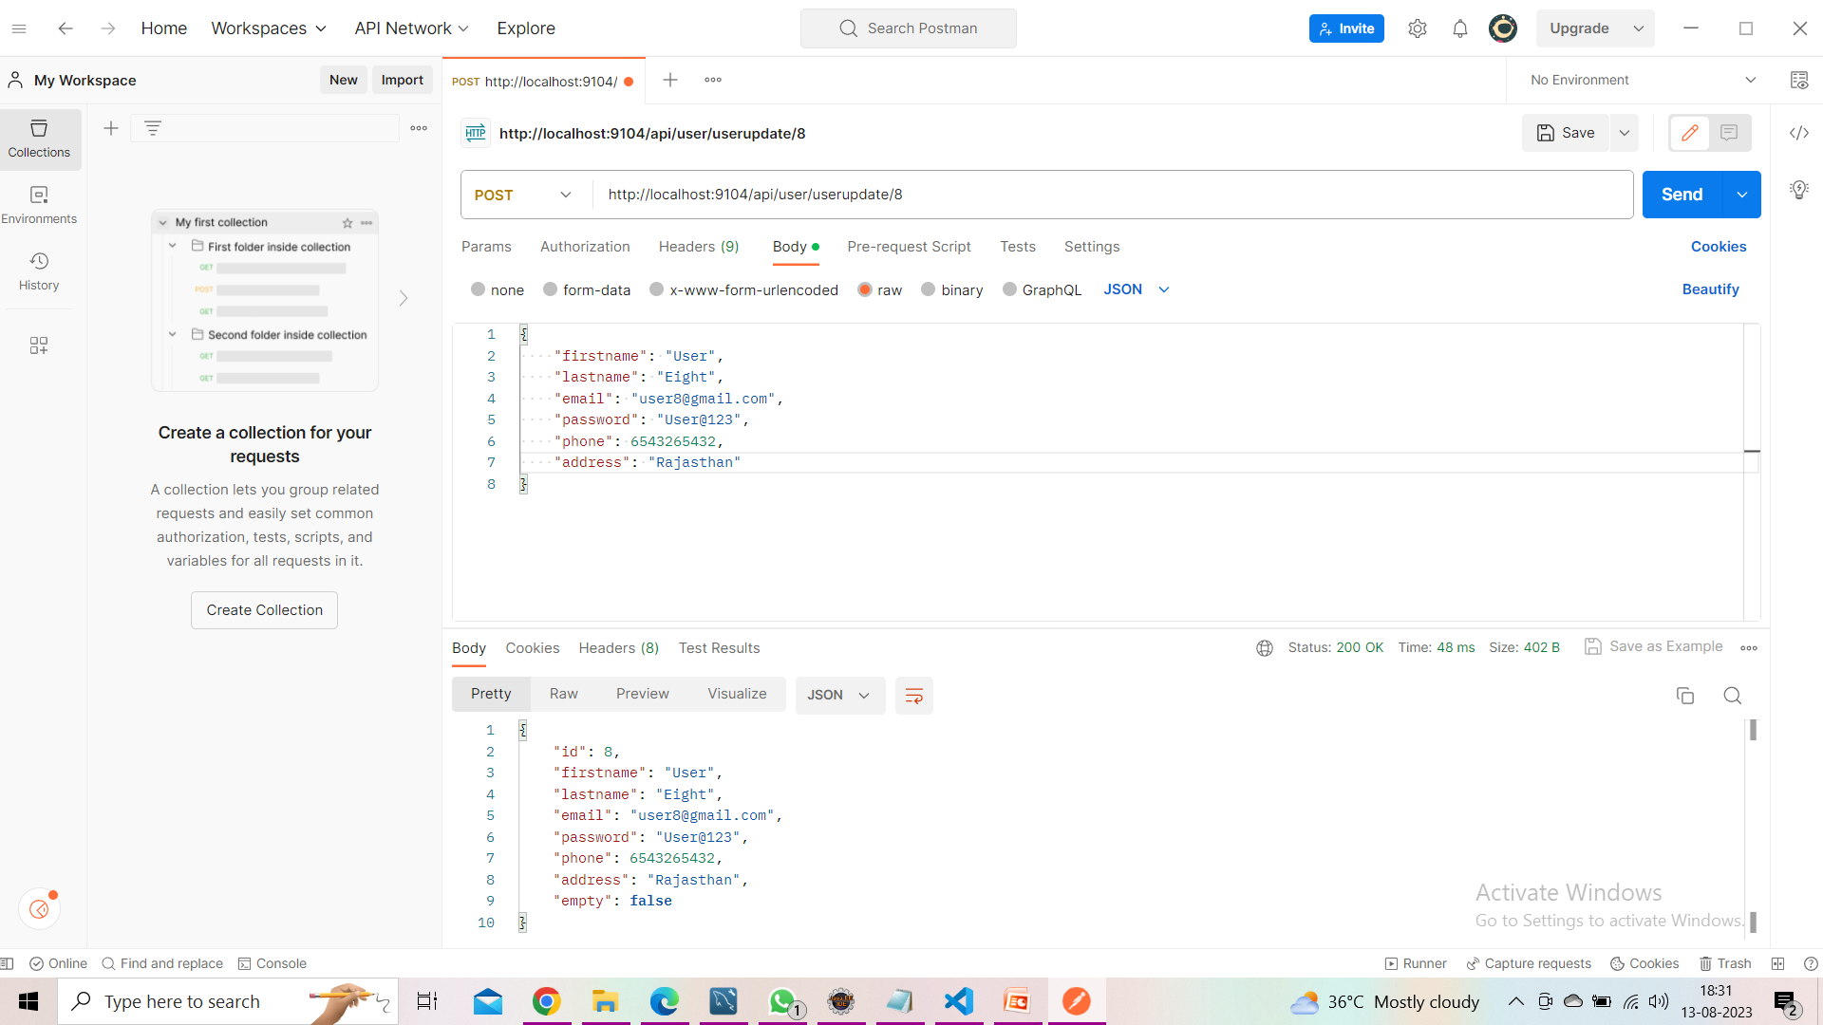
Updating User Profile in Postman

Slide 38
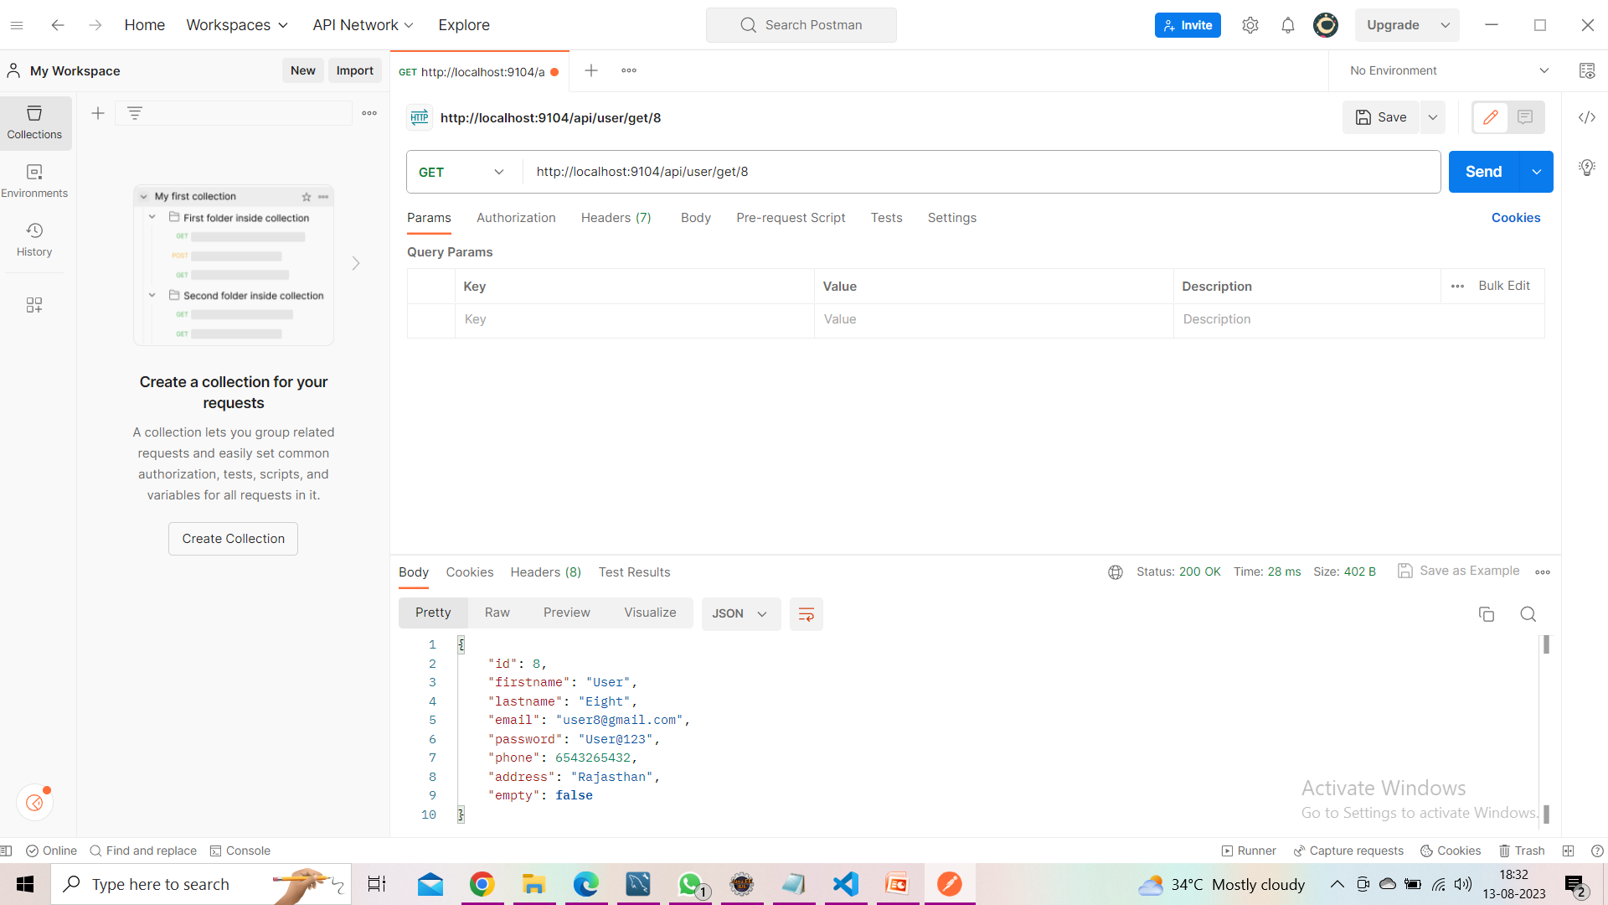
Checking the Updated User Profile

Slide 39
User Dashboard

Slide 40
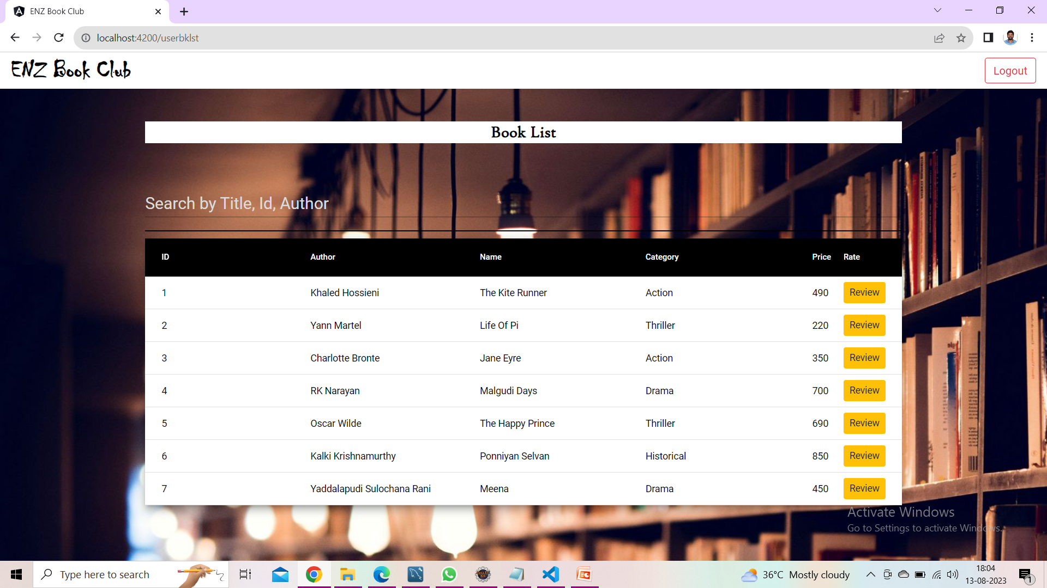
User BookList

Slide 41
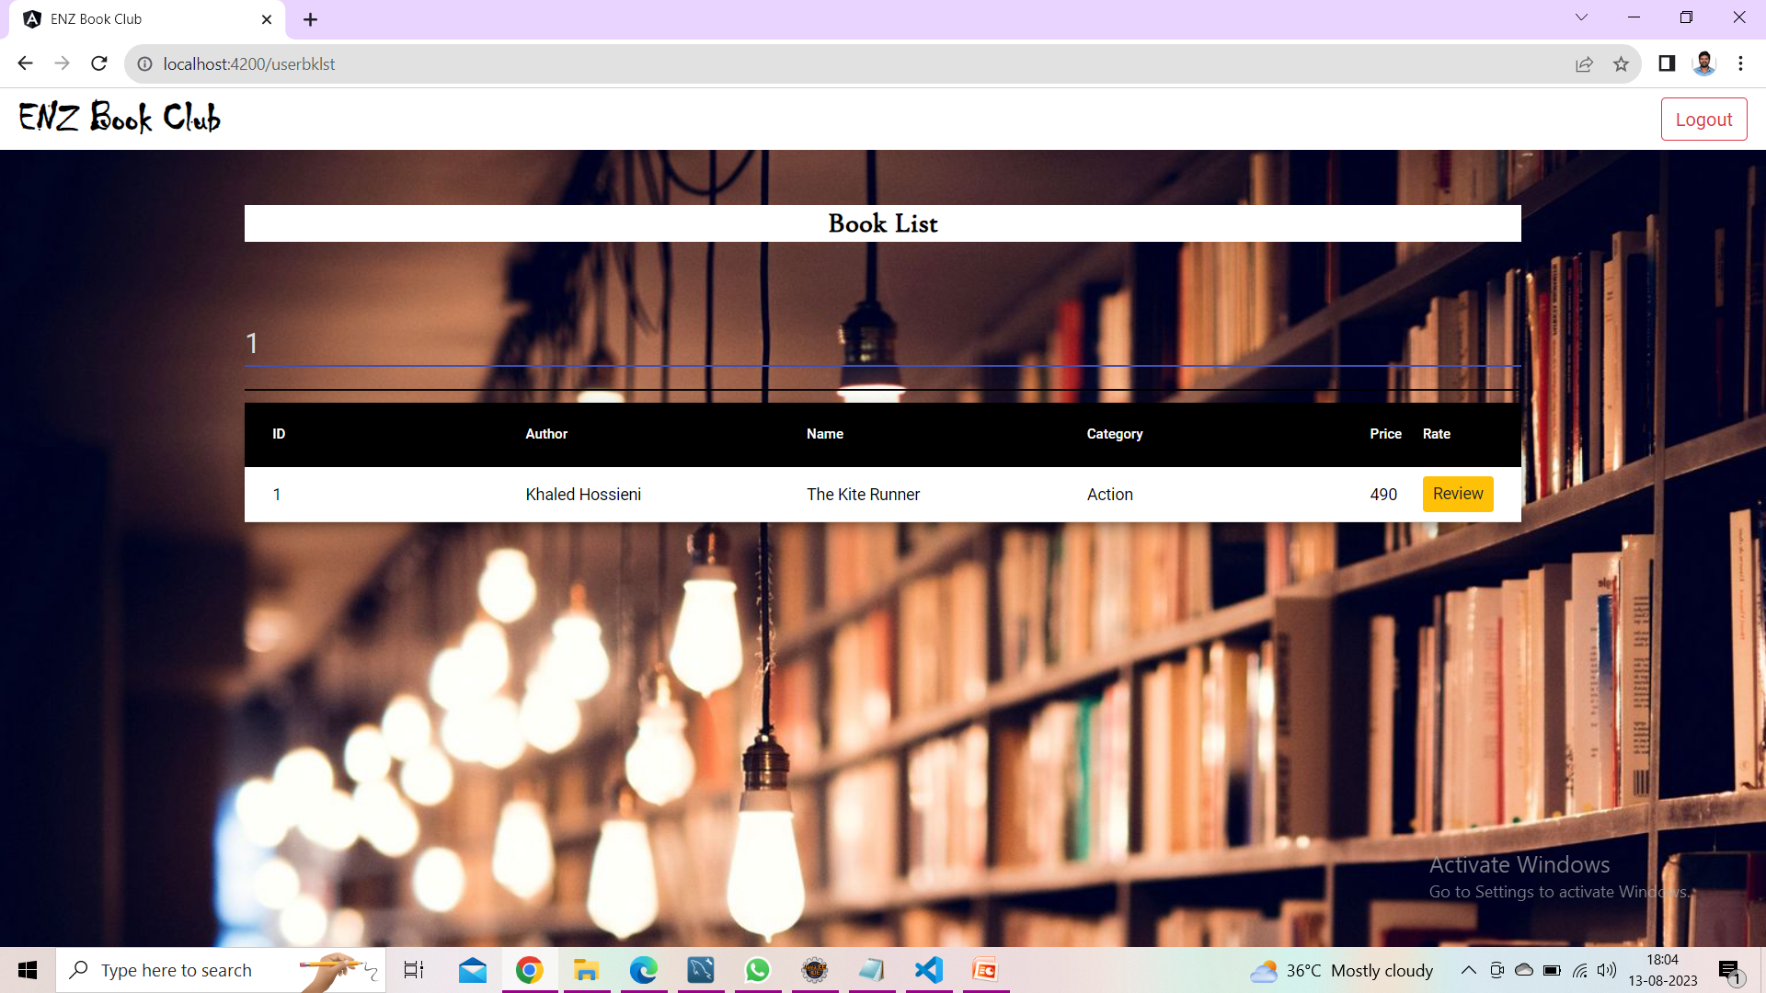
Searching for Book by Id

Slide 42

Searching for Book by Author

Slide 43

Searching for book by BookName

Slide 44
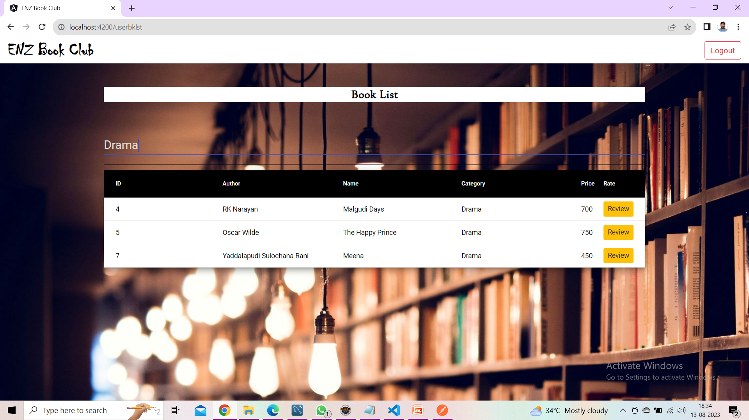
Searching for Book by Category

Slide 45
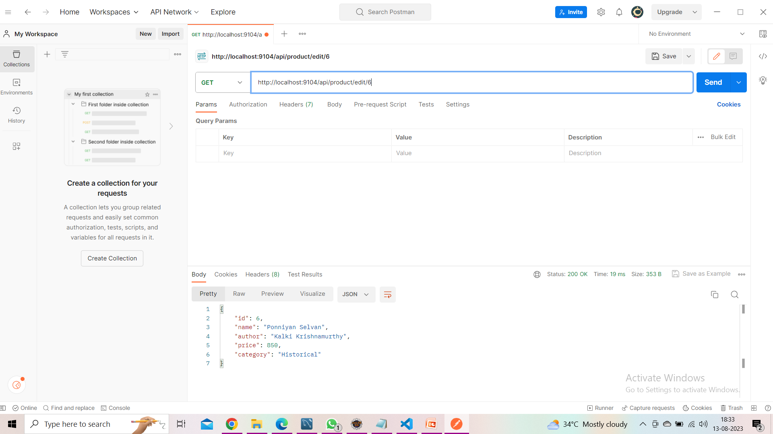
Searching for Book by Id in Postman

Slide 46
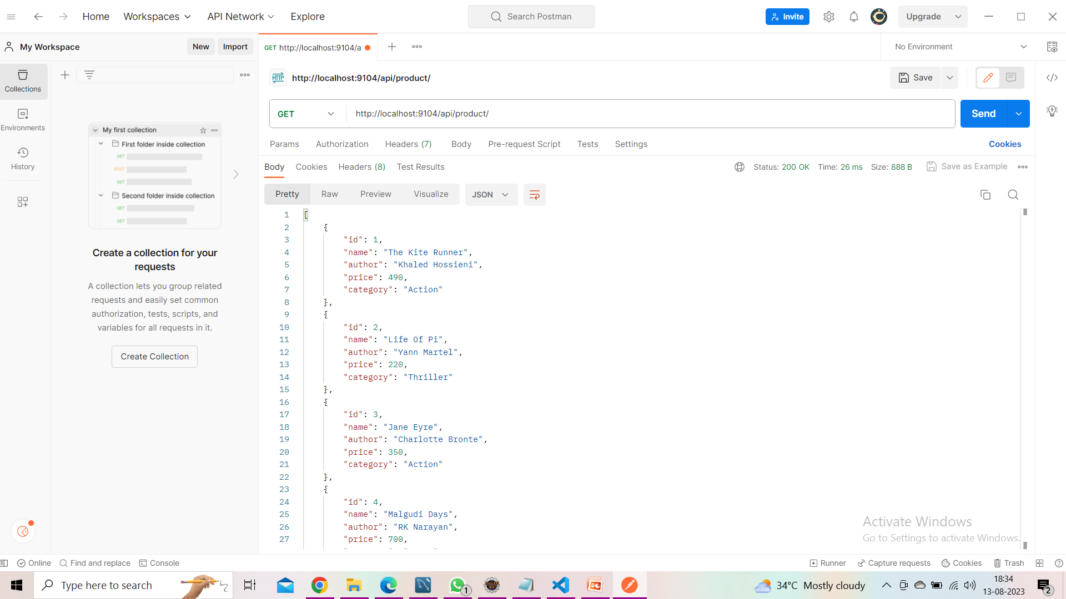
BookList in Postman

Slide 47
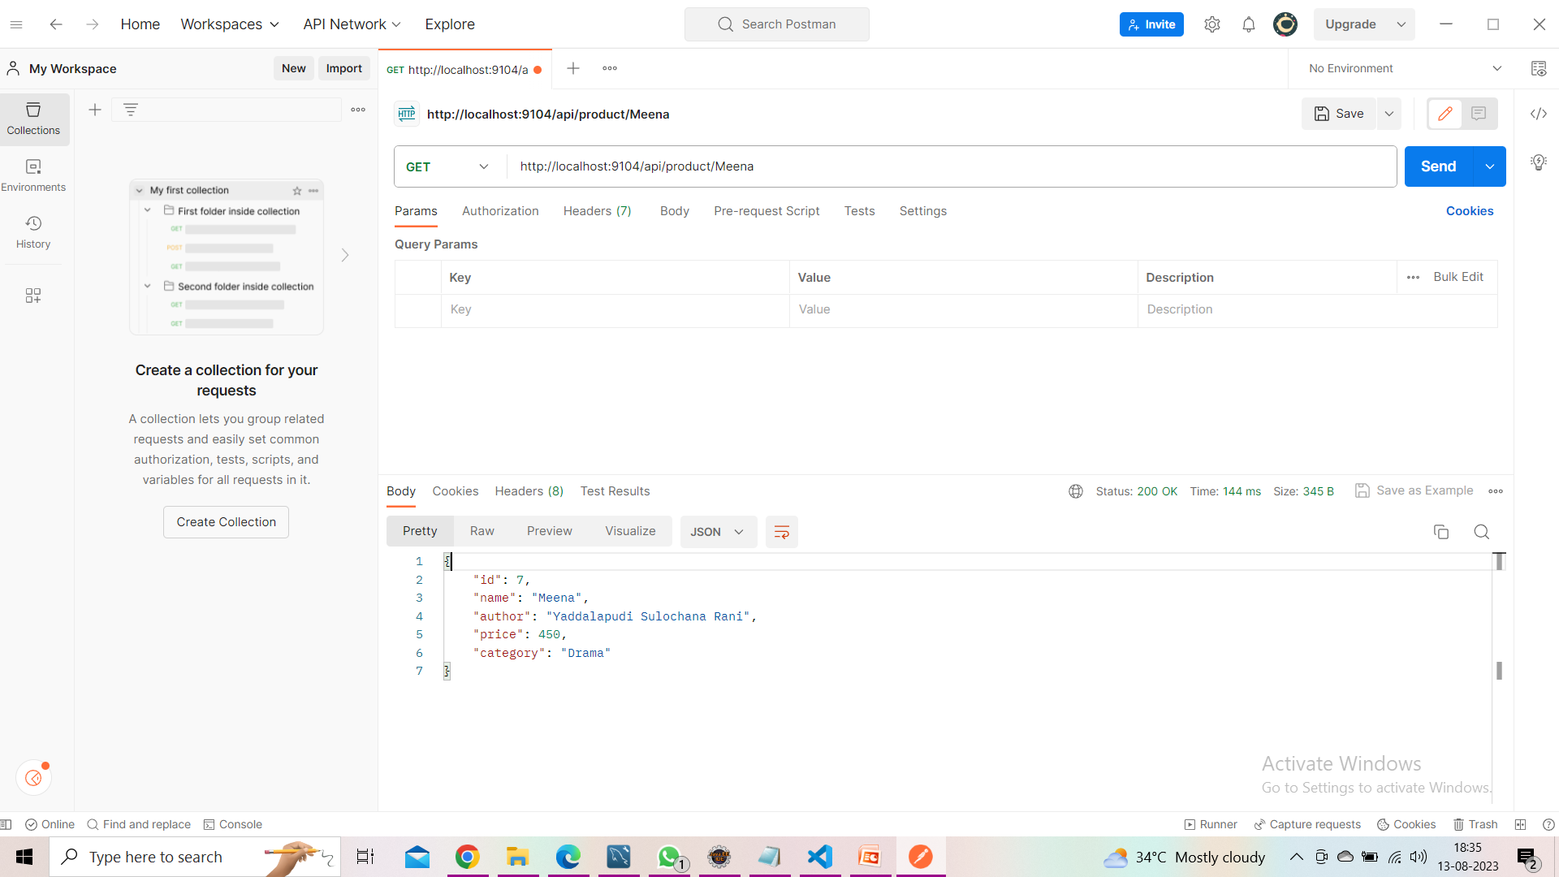
Searching for Book By BookName in Postman

Slide 48

User BookList

Slide 49
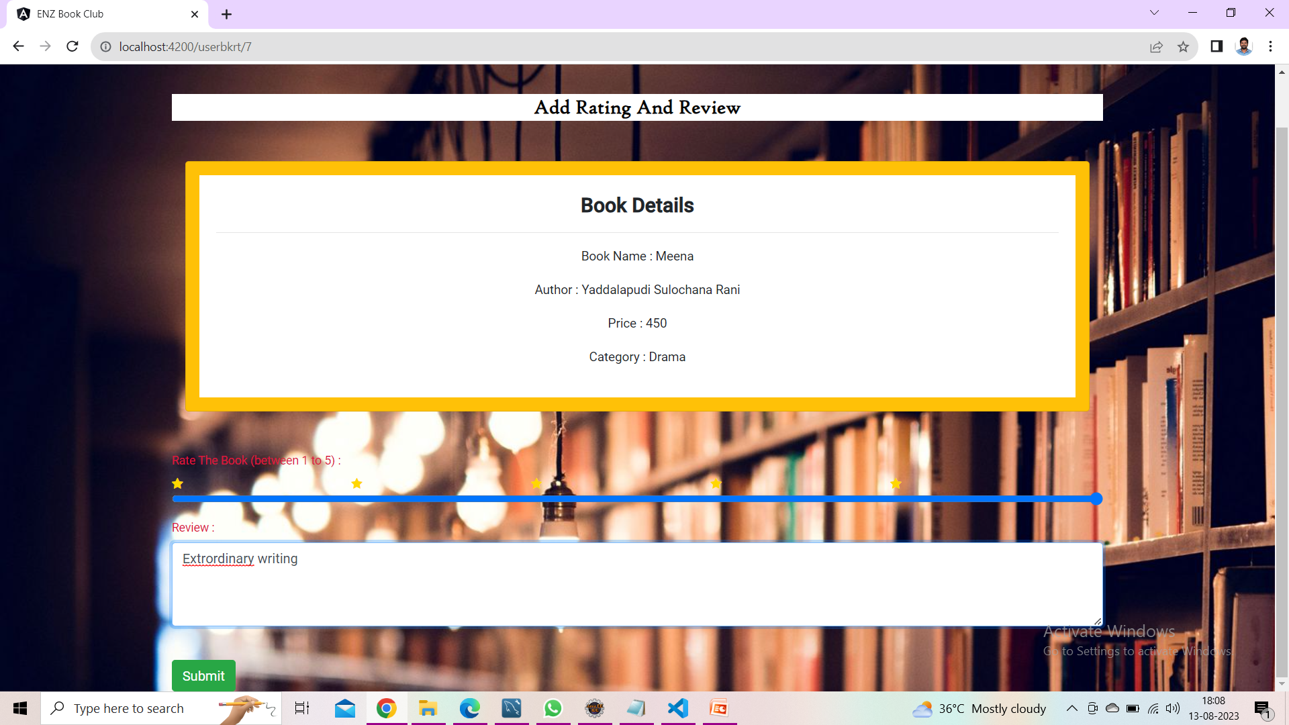
Add Rating and Review

Slide 50

Admin Dashboard

Slide 51
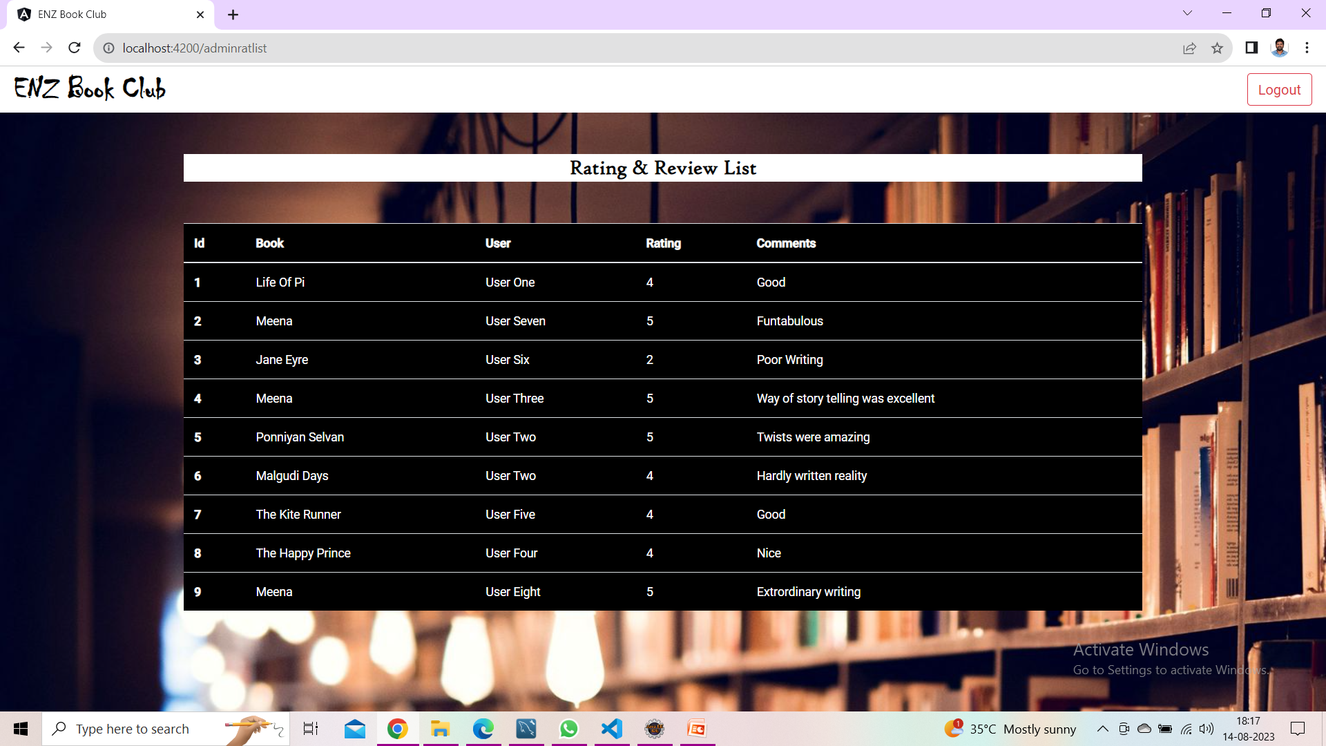
Rating and Review List

Slide 52
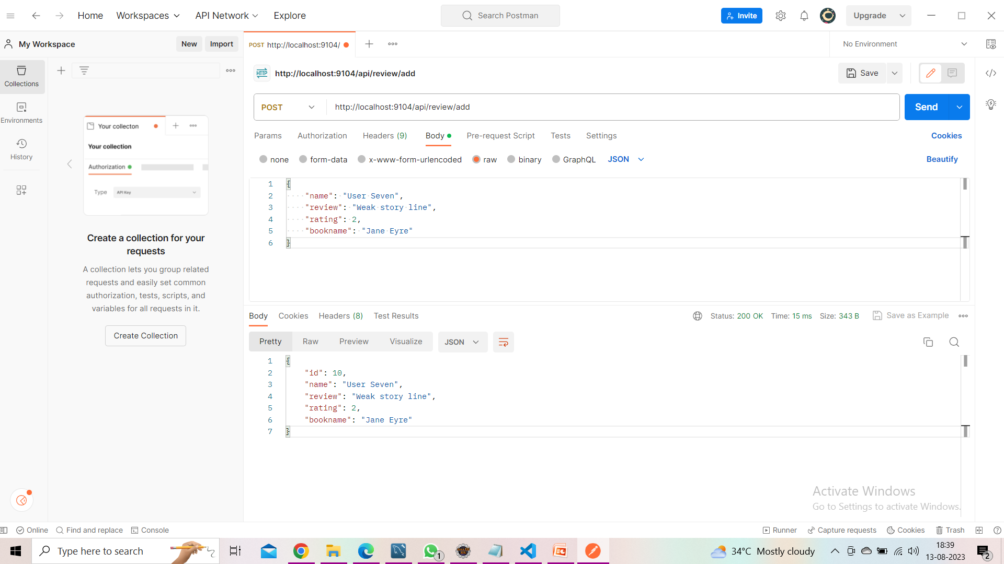
Adding Book Review in Postman

Slide 53
Conclusion :
A book review system gives a reader the better understanding of the books .
Allows the admin to better understand what it is the readers are looking for.
This gives books greater visibility and a greater chance of getting found by more readers

Slide 54
Future Scope :
Author Login and Register into an account
Designing the project that an author can view the reviews given for their book and allowing to comment on reviews

Slide 55


